Slide 1
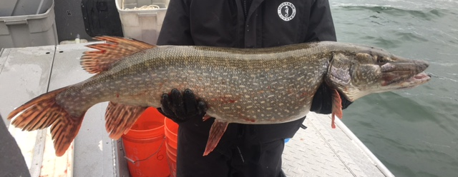
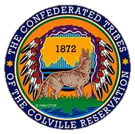
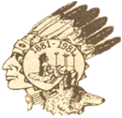
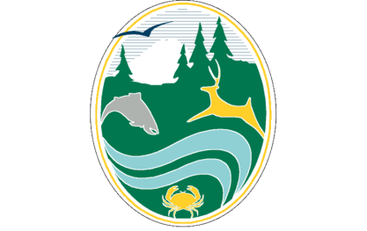
Lake Roosevelt Northern Pike Suppression and Monitoring -March 2020 Update
Confederated Tribes of the Colville Reservation: Holly McLellan and Shay Wolvert
in collaboration with the Spokane Tribe and Washington Department of Fish and Wildlife
Presented to The Fish Passage Operations and Maintenance Team Meeting; March 12, 2020

Slide 2
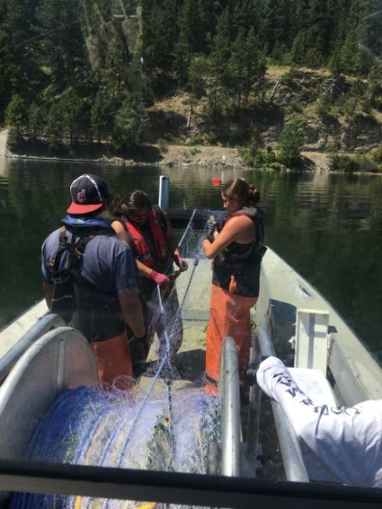
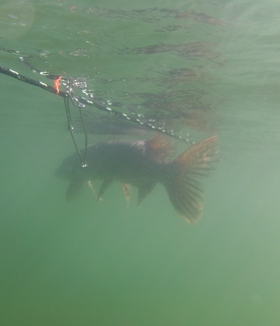
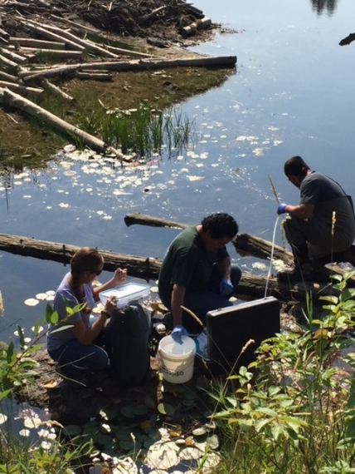
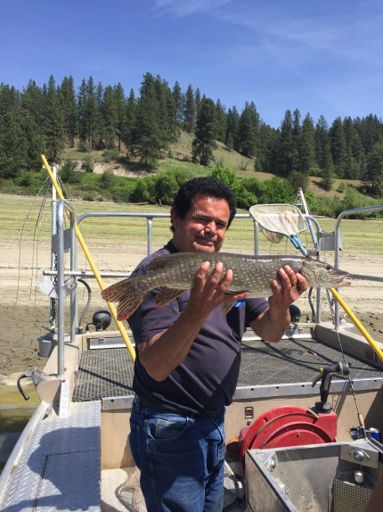
Northern Pike Suppression and Monitoring Program
Suppression Gear
  Gillnets (All)
  Setlines (CCT)
  Seines/ fyke nets (CCT/STI)
  Boat electrofishing (CCT/STI)
Monitoring
  Reservoir wide surveys (WDFW)
  Otolith microchemistry (CCT)
  eDNA monitoring (CCT)
Reward Program $10/head (CCT)
  Anglers can help protect Lake Roosevelt fisheries
Gillnetting
Setline
eDNA Sampling
Boat Electrofishing

Slide 3
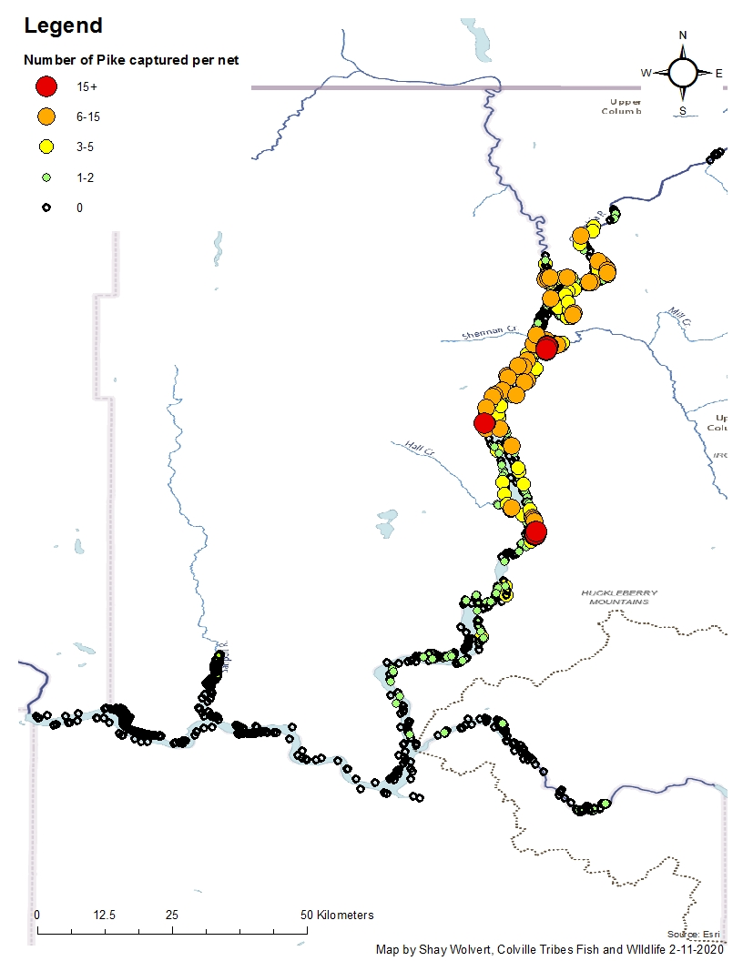
Lake Roosevelt Suppression
Since 2015, co-managers have removed 12,596 Northern Pike
Majority (99%) of Pike are captured in upper half of the reservoir
Pike are using the Kettle River for spawning
Likely new spawning locations in the Barnaby and Gifford areas.
In 2019, we set 430 nets from the Spokane River confluence to Grand Coulee and captured 3 Pike.
  Low densities in the lower section
Need to redo map

Slide 4
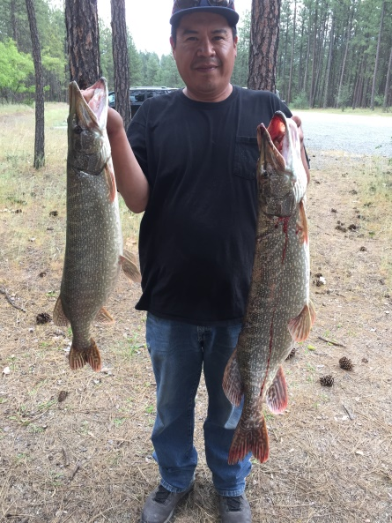
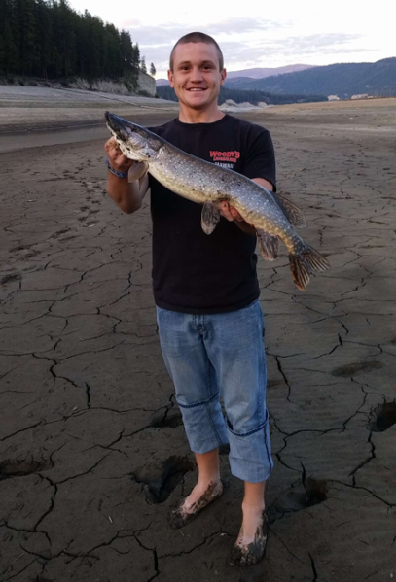
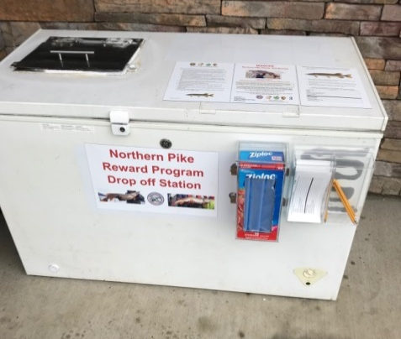
Reward Program
Program started in May 2017.
6 drop off freezer locations
Payout received 3 wks
In 2019, we gave out $3,730
Total to date, $20,710 to anglers

Slide 5
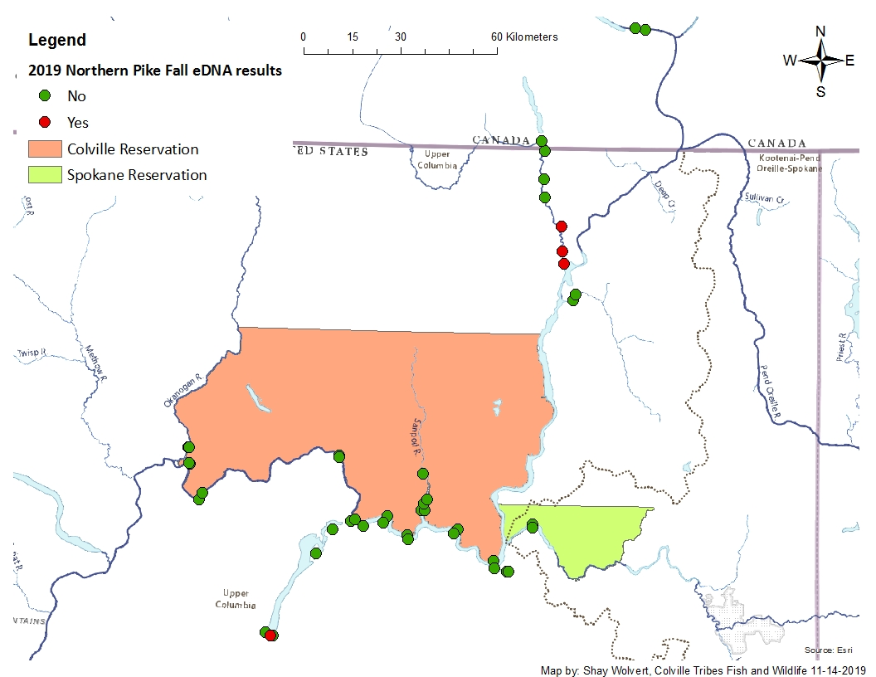
eDNA Monitoring
Monitor 70 sites (May/Sept)
  Douglas PUD monitors the Okanogan monthly
Kettle River
  Positive 39 km upstream
Banks Lake
  Positives; boat contamination?
Okanogan River
  Positive; Fish dump
  Good rapid response exercise
Keenleyside Dam
  Negative so far
Continue monitoring in 2020
Other agency monitoring

Slide 6
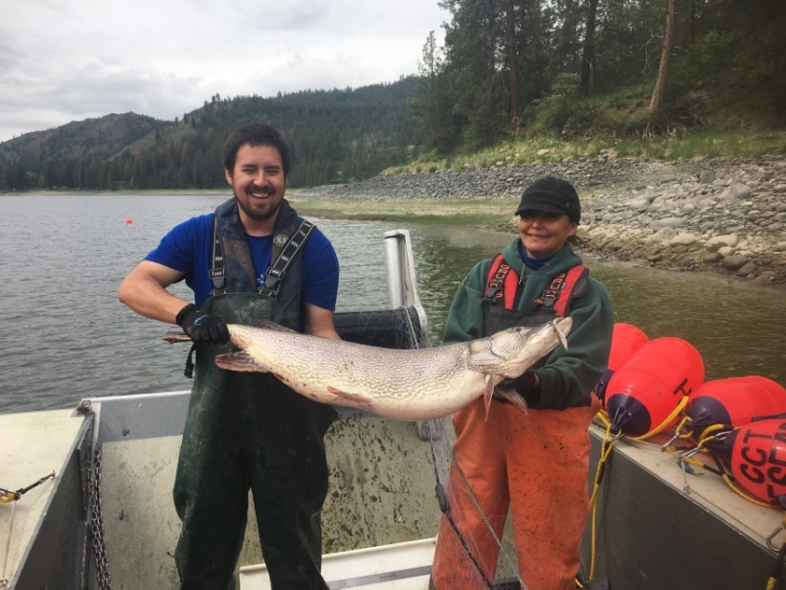
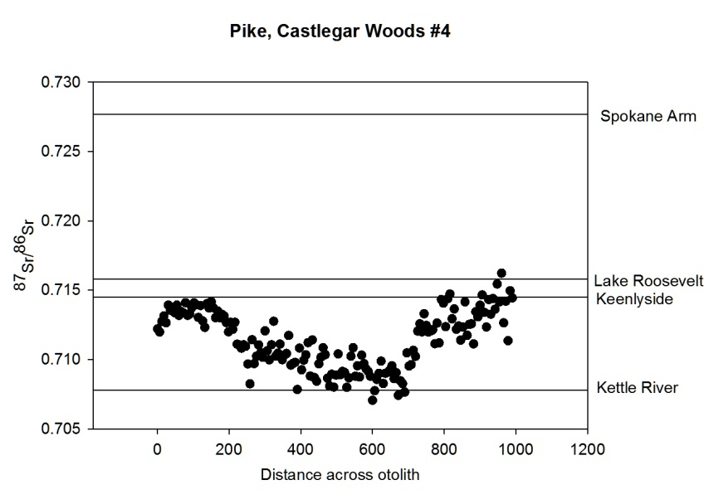
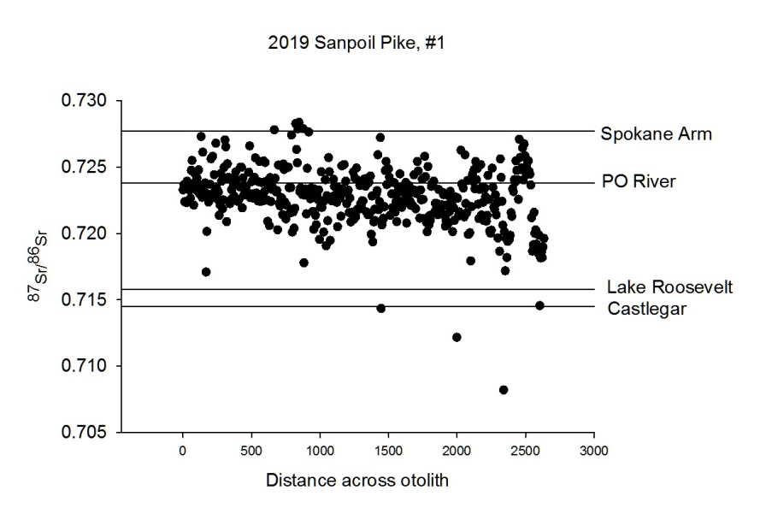
Otolith Microchemistry
Used to help understand fish movements
  Otoliths are analyzed for the concentration of strontium isotopes
2019 analyzed 41 Pike
  12 collected below Keenleyside Dam, BC
  24 from Lake Roosevelt and the Sanpoil
  5 Spokane River (below Little Falls)
Results indicate
  BC Pike- multiple life histories
    Entire life near Castlegar
    Originated in the Pend Oreille River
    Moved between Castlegar and Kettle River (shown)
  Spokane River Pike:
    All 5 Pike originated in the Columbia River
  Sanpoil River
    Potentially originated in PO River (shown)

Slide 7
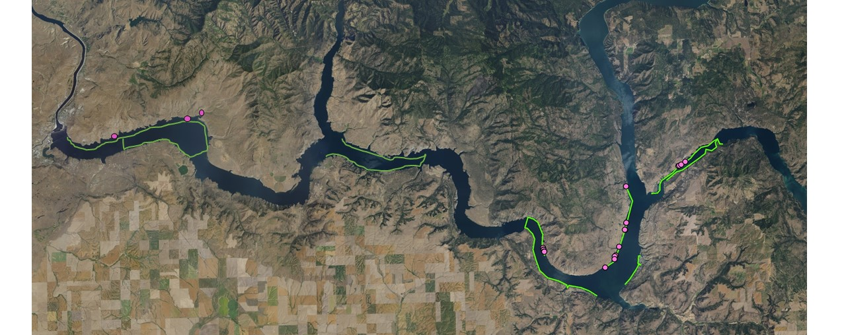
Flowering Rush
Northern Pike like to spawn on flowering rush (invasive species)
Beds on the Colville Tribes Reservation side of Lake Roosevelt found in 2019
Look for opportunities to collaborate to remove invasive plants in downstream reservoirs

Slide 8
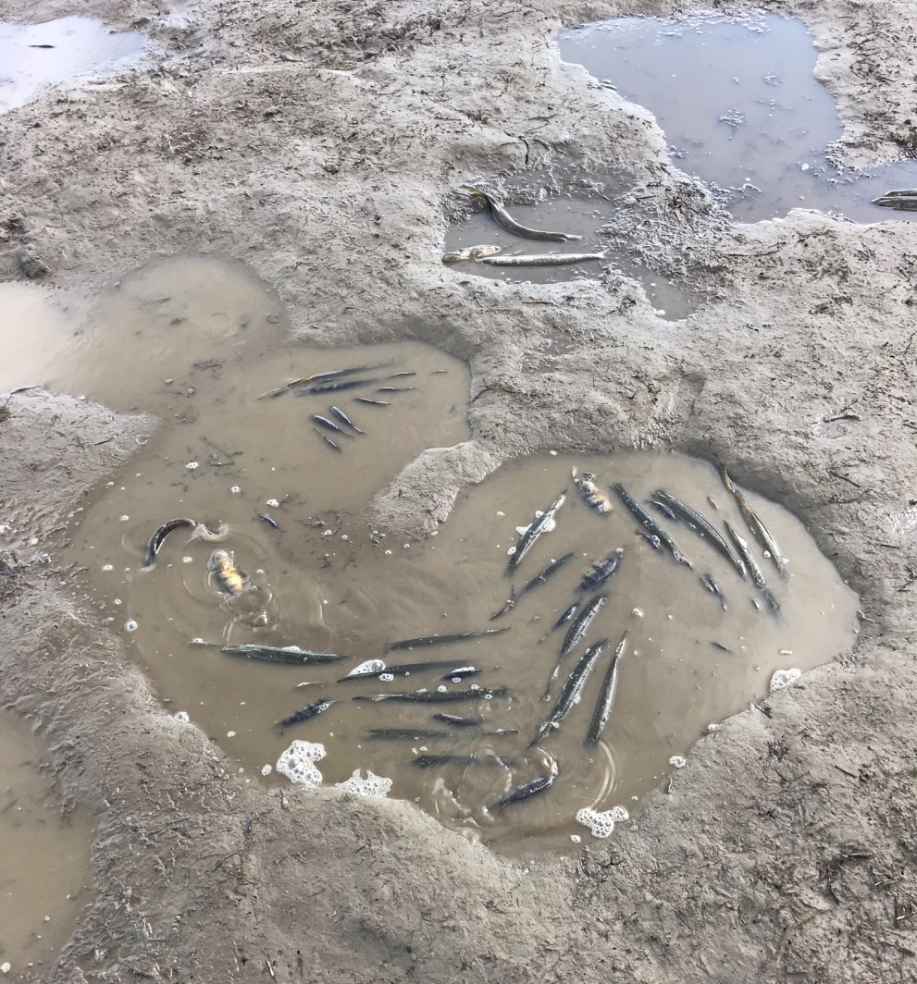
Pike Stranding
Pike move into shallow water in the spring
Pike become stranded during spring drawdown on flats
  Barnaby Flats, Kettle Flats
Fish composition
  74% Northern Pike
  24% Yellow Perch
  >1% Carp, Tench, RBT
99.8% non-native fish
Barnaby Flats – March 3, 2020

Slide 9
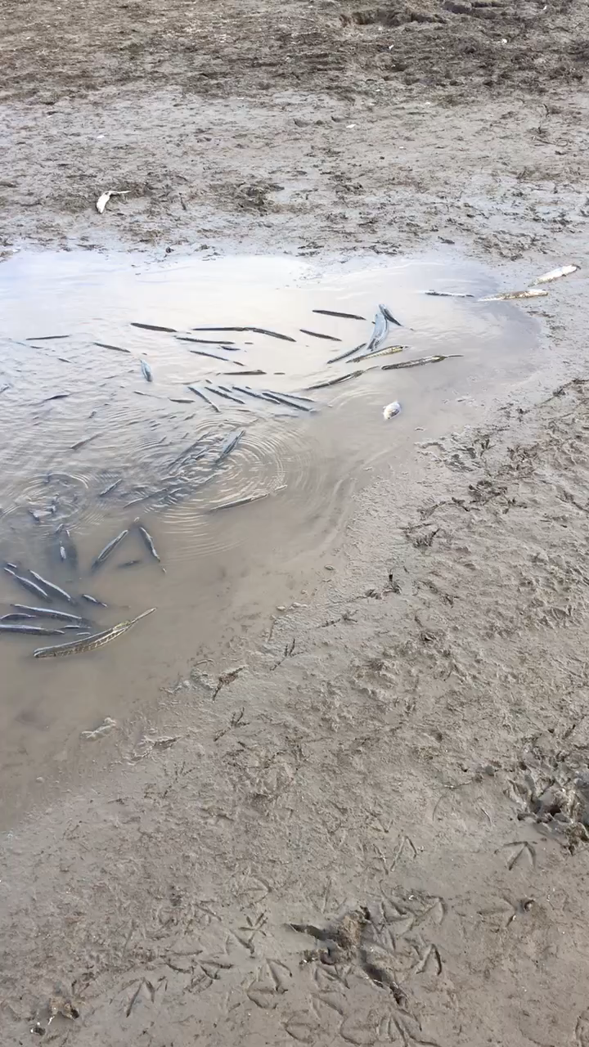
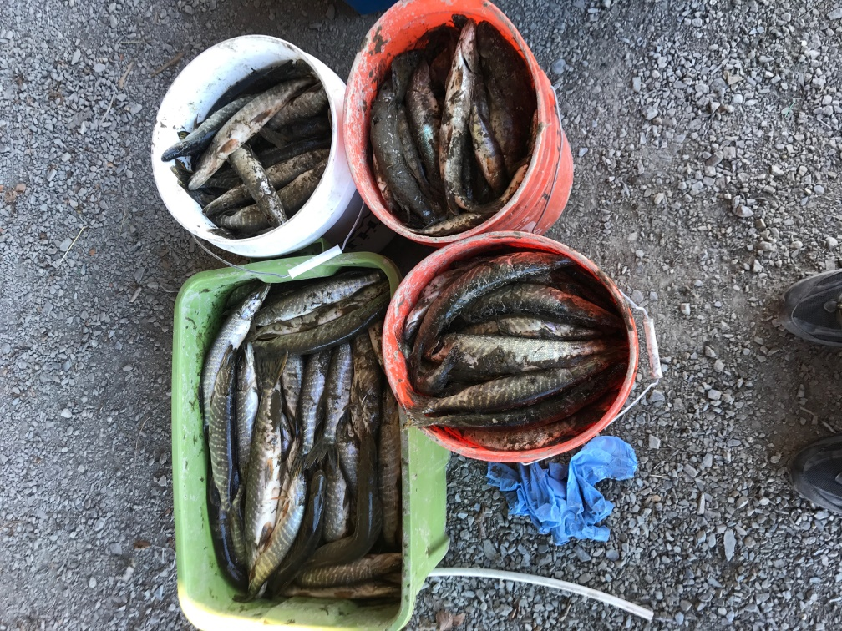
Barnaby Flats _ May 3 2020
404 Northern Pike
(elevation 1260)
Size Range 260-498 mm TL (10-20 in.)
50% females

Slide 10
Pike Stranding
Stranding starts in early March around 1260 msl
Continue to collect data on stranding
Future model development to use reservoir operations to kill large numbers of Pike in the spring

Slide 11
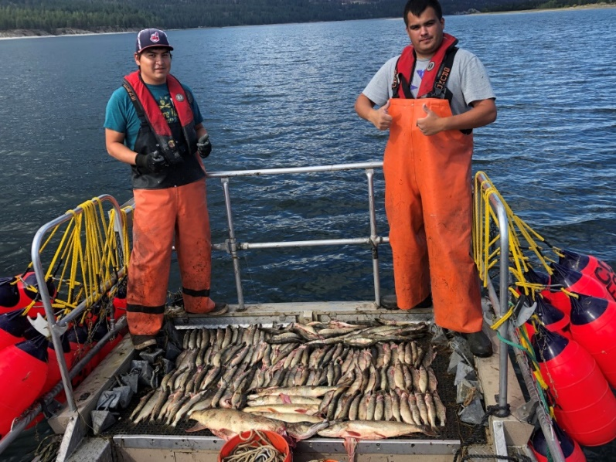
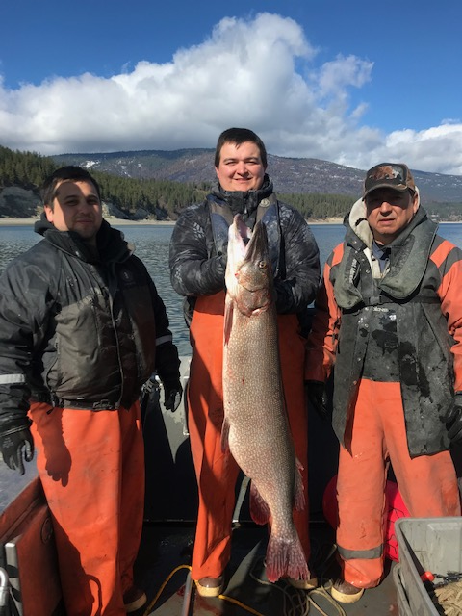
Looking to the future
The co-managers of Lake Roosevelt will continue to look for funding and implement suppression and monitoring in Lake Roosevelt through at least 2025.
At that time, our technical team will reconvene and adaptively manage the future direction of the program.

Slide 12
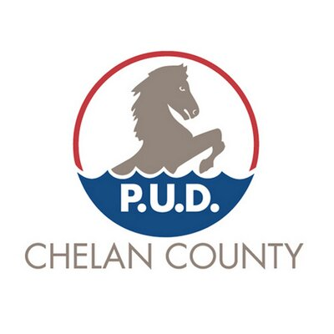

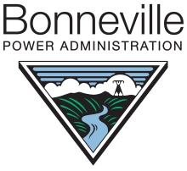




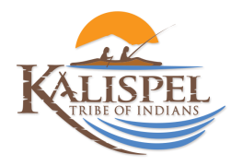


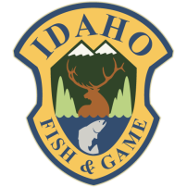

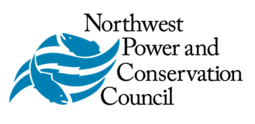

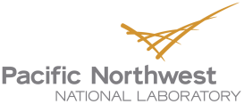
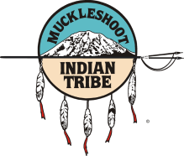
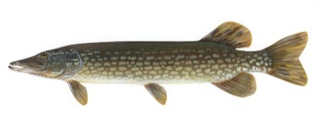


Questions?
Many thanks to our amazing partners

